Slide 1
Customer Defection
Helping NPC retain its valuable customers
Ryan McMurray, Matt Gallagher, Caitlin Pinkard
Notes:
Matt

Slide 2
Problem Statement
Objective
Build a model to predict which customers are most likely to churn
Determine customers most likely to churn
Tables: customers, credits, formula, deliveries, subscriptions, complaints
Notes:
Matt

Slide 3
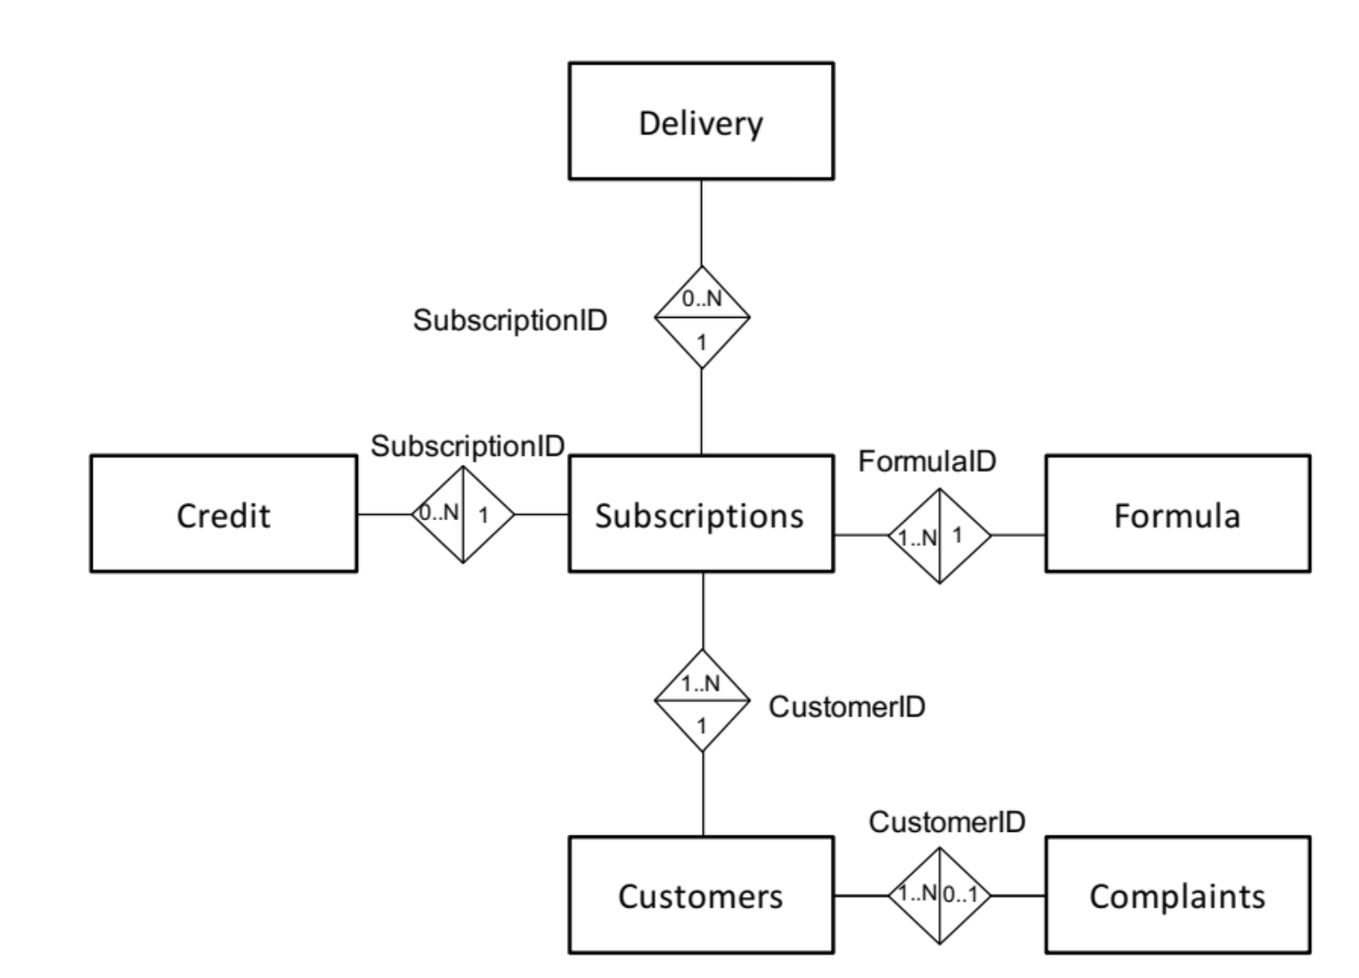
ERD
Notes:
Matt

Slide 4

Code FlowChart
Credit
Formula
Delivery
Complaints
Aggregate and merge on subscription
Aggregate and merge on customers
Filter on subscription time period
Subscription
Customers
Final model predicting customer churn with 0.98 AUC
FinalBase
One row per customer
Churn -> if customer hasn’t renewed within the last 3 months
Random Forest
100 trees
Notes:
Caitlin

Slide 5
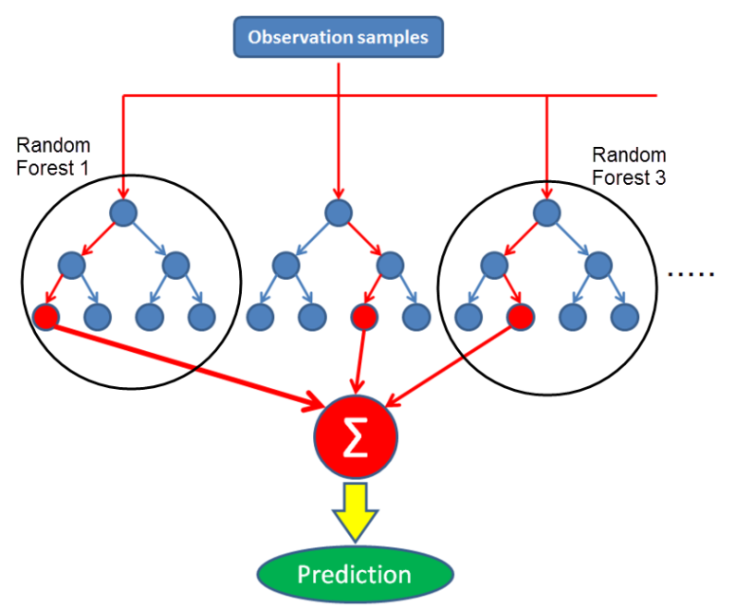
Model Performance
Simpler model (Logistic Regression)
Accuracy: ~70%
Advanced model (Random Forest)
AUC: 0.98
Top Decile Lift: 1.43
Lines of code: ~250
Runtime: 1 second
Notes:
Caitlin

Slide 6
Recommendations
Create an initial discount to join, but otherwise limit changes in price
Meet the needs of the reader: Appeal to small markets where there is less competition
Offer “spectacular” customer service
Notes:
Ryan

Slide 7
Future Work
Build simpler models with only significant predictors
Focus on those that we incorrectly classified as non-churners (1% false negatives)
Work with company to develop a better churn definition
Notes:
Ryan

Slide 8

Questions?

